Slide 1


STAT41130: AI for Weather and Climate
Andrew Parnell

Slide 2
Course Introduction
Quick round table
Tools for this course:
AI by Hand by Tom Yeh: www.byhand.ai
Artificial Intelligence Forecasting System (AIFS),
Anemoi: https://github.com/ecmwf/anemoi-core
This is a hands-on course, mixing manual calculation and coding
Weather and climate are motivating applications, but the topics are generally useful

Slide 3
Github repo
All information at: https://github.com/andrewcparnell/STAT41130
Contains slides (PPT files), code (Python script files), but not the AI-by-hand worksheets (see web for these)
To access the material either:
Use git directly to download the materials
Go to the website and click: Code -> Download Zip
If you find typos/bugs either:
Let me know (basic)
File an issue on the GitHub page (intermediate)
Create a Pull Request and fix it yourself (advanced, and most helpful)

Slide 4
About this course
Learn to build and evaluate ML models for weather forecasting for use in your research
01
Understand what the models are doing in the background so that you can extend them
02
Work with real meteorological datasets and simulations
03

Slide 5
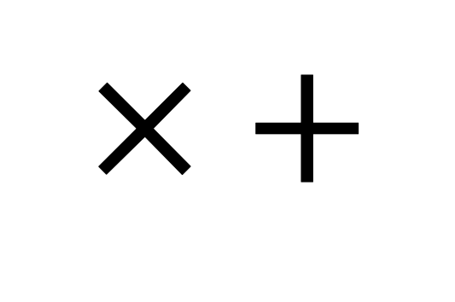
Who is this course for?
Designed for students with either AI or weather/climate background
No deep prior experience in either area required
Collaboration across disciplines is strongly encouraged
Lots of interaction and group work
Need you to download and install PollEverywhere on your phone: https://www.polleverywhere.com/
Main expert tools you need are:
$$× +$$

Slide 6
Structure of course
8 days:
2 1-hour lectures in the morning
1 1-hour guided coding class
2-3 hour self-guided coding exercise sheets in the afternoon
Computing labs use pytorch, AIFS and Anemoi
Lectures start from assuming no knowledge about NNs
Expect short quizzes, coding tasks, and pen-and-paper exercises
First quiz…

Slide 7
Syllabus (week 1)
Linear regression and neural networks
NNs and back-propagation
Deep learning
Convolutional NNs
Recurrent NNs
Graph NNs
Transformers

Slide 8
Syllabus (week 2)
Overview – data-driven weather forecasting
Effective data loading lecture
Anemoi graphs lecture
Anemoi training lecture
Probabilistic training lecture
Intro to parallel training lecture
Hackathon across anemoi packages
Anemoi profiling interactive

Slide 9

Notes:
Do not modify the notes in this section to avoid tampering with the Poll Everywhere activity. More info at polleverywhere.com/support In one or two words how would you describe your expertise? (e.g. Data Scientist, Meteorologist, Climate scientist, etc)
https://www.polleverywhere.com/free_text_polls/nsj1L6mLgbYEZsIFCTItp

Slide 10
Lecture 1: Linear regression to Neural networks

Slide 11
Learning outcomes
Reminder of linear regression (LR)
How to fit linear regression models
Thinking about LR as a neural network
Fitting LR like a neural network

Slide 12
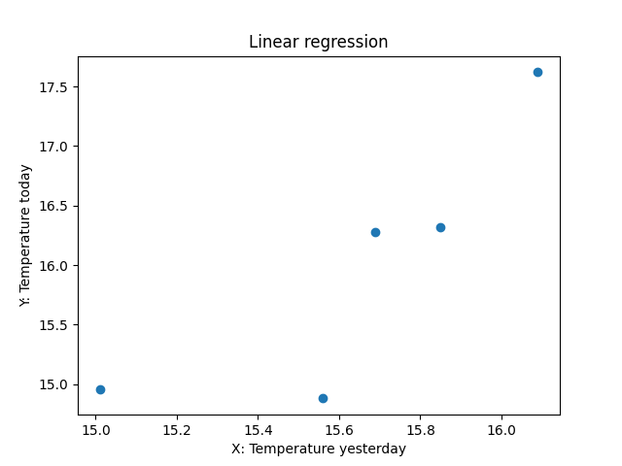
Drawing straight lines of best fit
Super simple data set:
X = [16.09, 15.56, 15.85, 15.69, 15.01]
y = [17.62, 14.88, 16.32, 16.28, 14.96]
X = temperature yesterday
Y = temperature today
Want a simple straight line of best fit through it

Slide 13
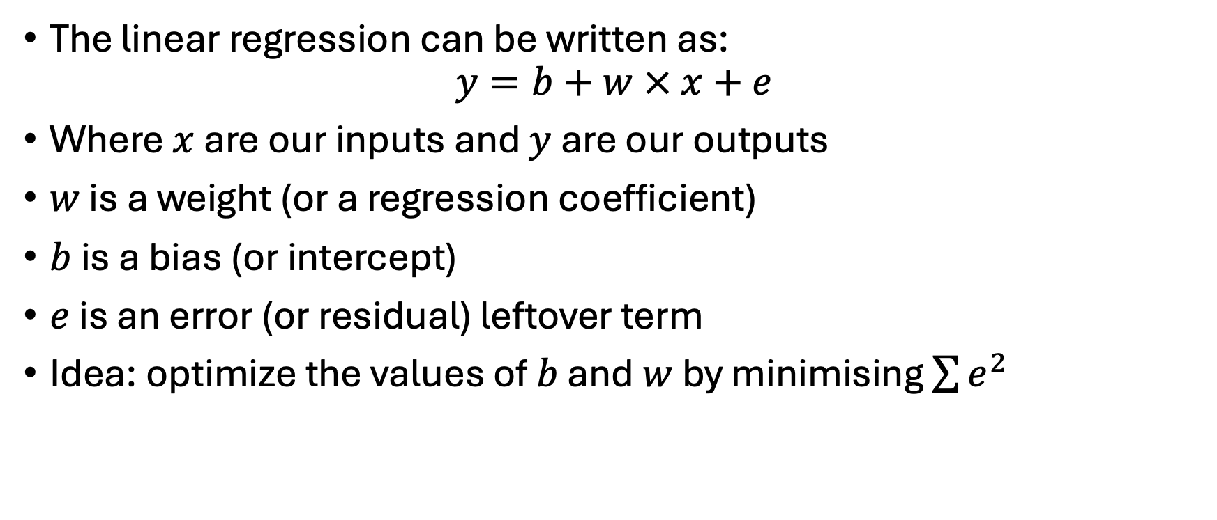
Foundations of linear regression
The linear regression can be written as:
$$y=b+w × x+e$$
Where $x$ are our inputs and $y$ are our outputs
$w$ is a weight (or a regression coefficient)
$b$ is a bias (or intercept)
$e$ is an error (or residual) leftover term
Idea: optimize the values of $b$ and $w$ by minimising $\sum{e^{2}}$

Slide 14
Poll EV Question
Given the data what do you think will fit better w = 0 b = 0.5 or w = 1 and b = 1?

Slide 15
Example
b = 0
w = 0.5
sum_of_squares = np.sum((y - (b + w * X)) ** 2)
print(sum_of_squares)
# Residual sum of squares for b=0, w=0.5: 339.3
b = 1
w = 1
sum_of_squares = np.sum((y - (b + w * X)) ** 2)
print(sum_of_squares)
# Residual sum of squares for b=1, w=1.: 4.6

Slide 16
More intuition
w (weight) controls the slope of the line
b (bias) shifts the line up or down
Predicts continuous target values
Assumes linearity between input and output
Can fit this model exactly using calculus

Slide 17
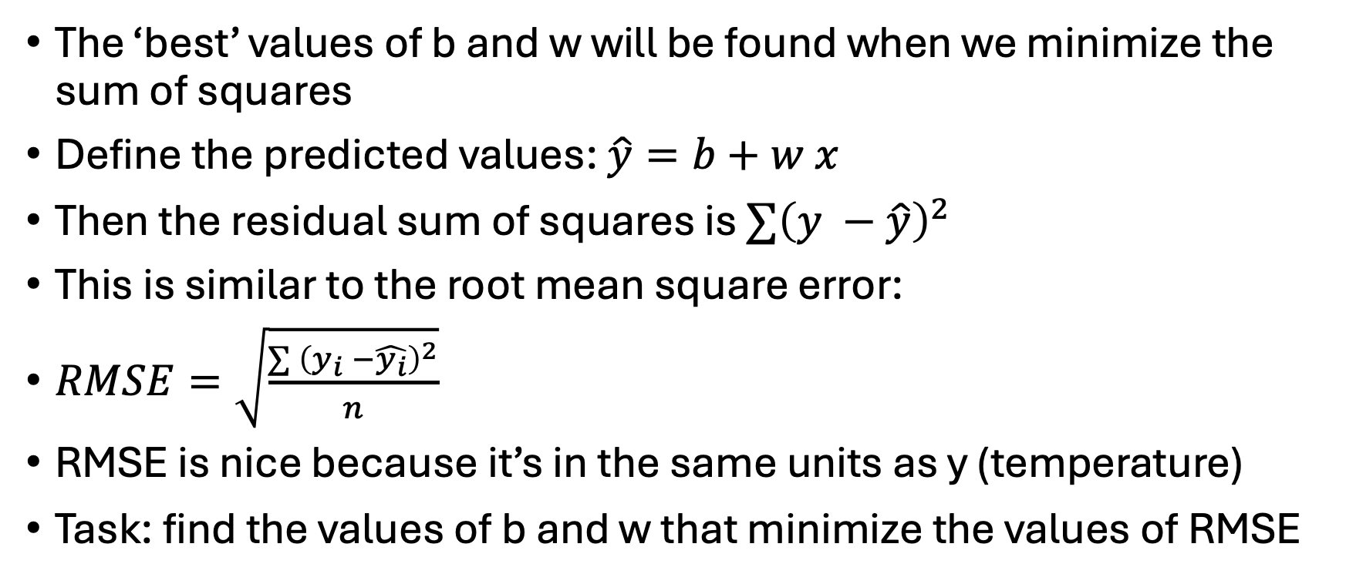
The loss function
The ‘best’ values of b and w will be found when we minimize the sum of squares
Define the predicted values: $\hat{y}=b+w x$
Then the residual sum of squares is $∑{\left(y −\hat{y}\right)}^{2}$
This is similar to the root mean square error:
$RMSE=\sqrt{\frac{∑{ \left(y_{i} −\hat{y_{i}}\right)}^{2}}{n}}$
RMSE is nice because it’s in the same units as y (temperature)
Task: find the values of b and w that minimize the values of RMSE

Slide 18
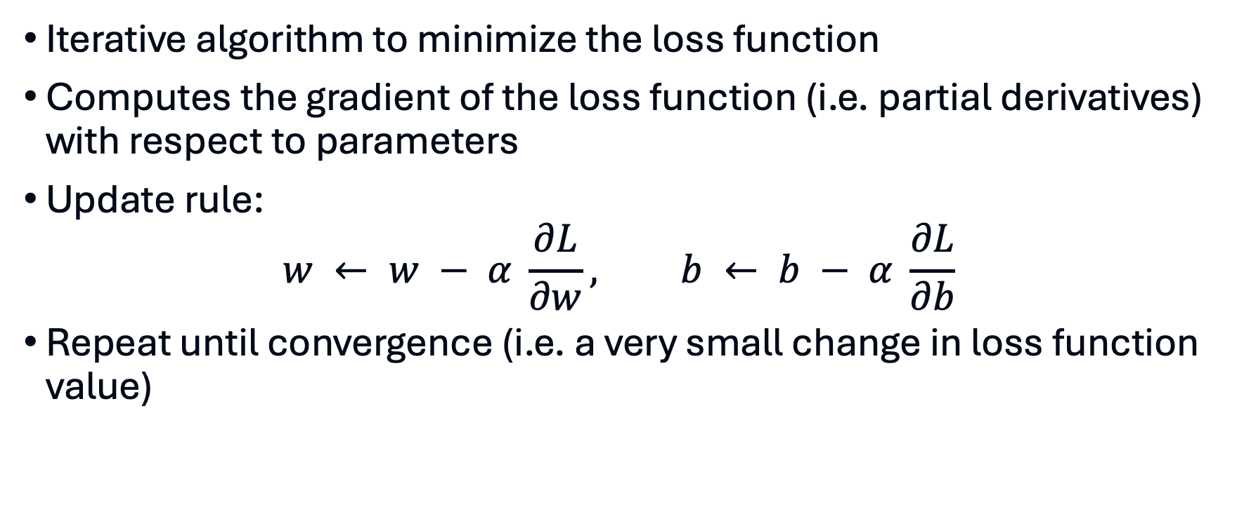
Solution via gradient descent
Iterative algorithm to minimize the loss function
Computes the gradient of the loss function (i.e. partial derivatives) with respect to parameters
Update rule:
$$w ← w − α \frac{∂L}{∂w}, b ← b − α \frac{∂L}{∂b}$$
Repeat until convergence (i.e. a very small change in loss function value)

Slide 19
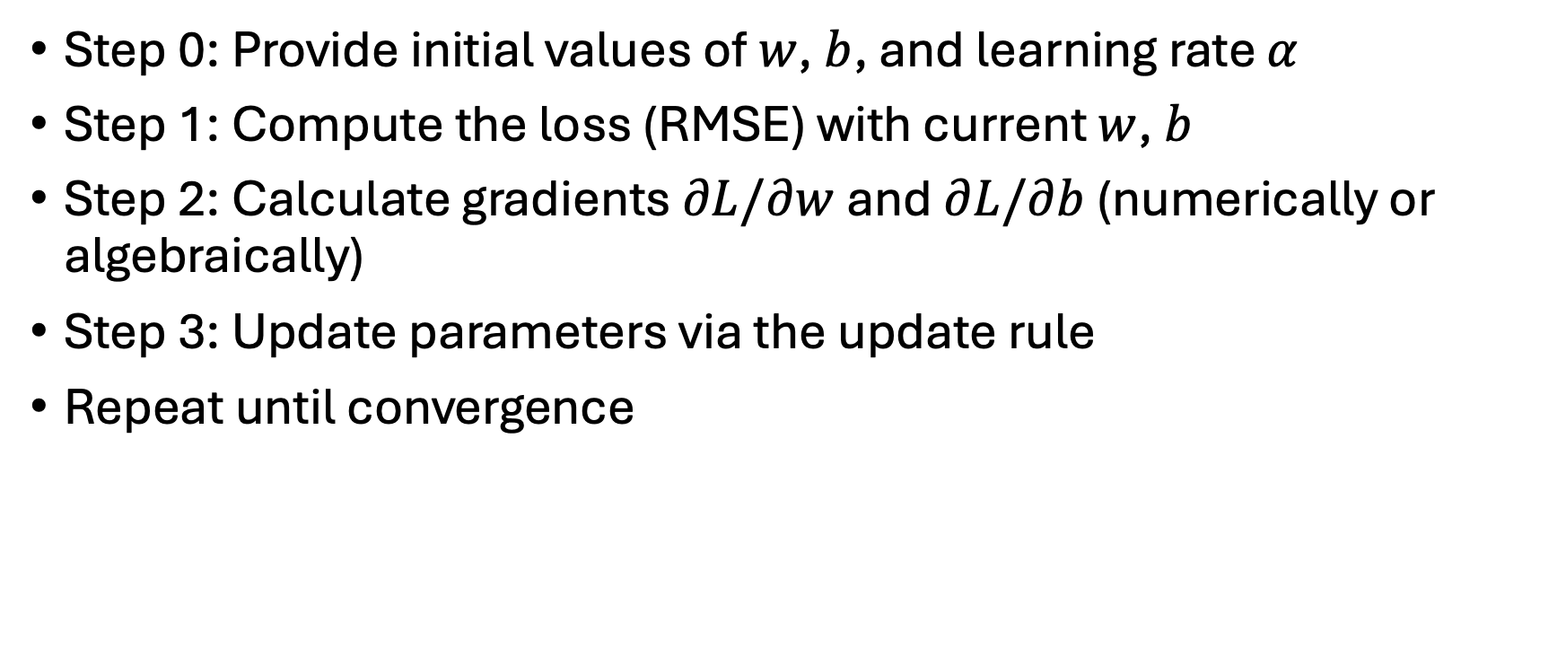
Algorithm
Step 0: Provide initial values of $w$, $b$, and learning rate $α$
Step 1: Compute the loss (RMSE) with current $w$, $b$
Step 2: Calculate gradients $∂L/∂w$and $∂L/∂b$ (numerically or algebraically)
Step 3: Update parameters via the update rule
Repeat until convergence

Slide 20
In action
w, b = 0.0, 0.0
alpha = 0.01
epochs = 100
losses = []
for epoch in range(epochs):
dw, db = compute_gradients(X, y, w, b)
w -= lr * dw
b -= lr * db
loss = rmse(y, predict(X, w, b))
if epoch % 10 == 0:
print(f'Epoch {epoch}, Loss: {loss:.4f}, w: {w:.4f}, b: {b:.4f}')
losses.append(loss)

Slide 21
In action
Epoch 0, Loss: 8.1828, w: 0.5015, b: 0.0320
Epoch 10, Loss: 0.7277, w: 1.0198, b: 0.0649
Epoch 20, Loss: 0.7276, w: 1.0204, b: 0.0647
Epoch 30, Loss: 0.7276, w: 1.0204, b: 0.0645
Epoch 40, Loss: 0.7276, w: 1.0204, b: 0.0643
Epoch 50, Loss: 0.7276, w: 1.0204, b: 0.0640
Epoch 60, Loss: 0.7276, w: 1.0204, b: 0.0638
Epoch 70, Loss: 0.7276, w: 1.0204, b: 0.0636
Epoch 80, Loss: 0.7276, w: 1.0205, b: 0.0634
Epoch 90, Loss: 0.7276, w: 1.0205, b: 0.0631

Slide 22
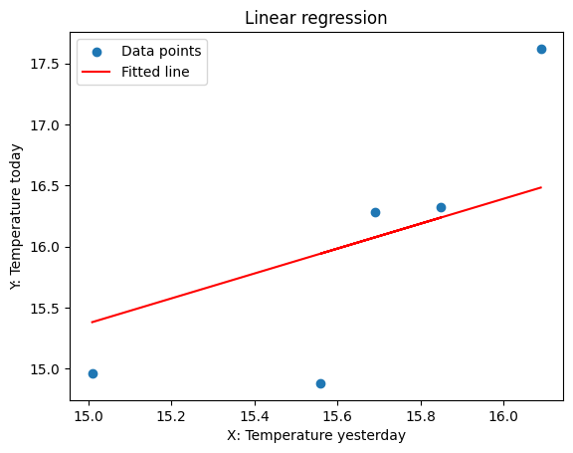
Plotting the fit

Slide 23
Learning rate
α controls the step size in gradient descent
Too small: slow convergence; too large: divergence
Often chosen empirically or via learning rate schedules
Adaptive optimizers (e.g. Adam, RMSProp) adjust the rate automatically

Slide 24
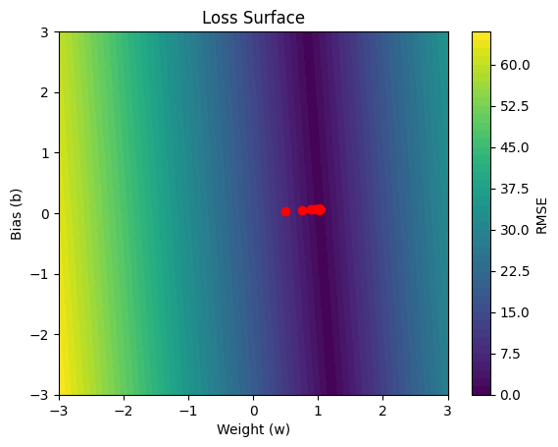
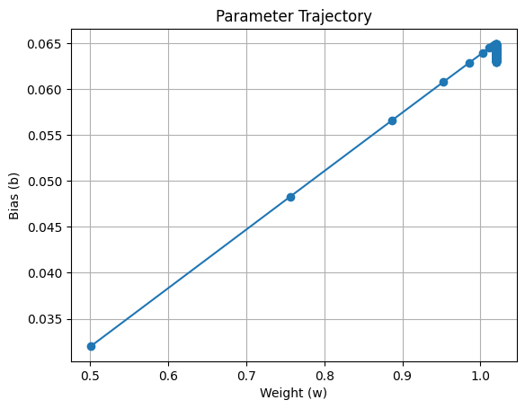
Parameter trajectories

Slide 25
Batch vs stochastic gradient descent
Batch GD: uses entire dataset each iteration; smooth but computationally heavy
Stochastic GD: updates using one sample; faster but noisy
Mini‑batch GD: compromise between the two
Noise in SGD can help escape shallow minima

Slide 26
Feature Scaling & Normalization
Inputs on different scales slow down optimization
Standardize by removing the mean and scaling to unit variance
Alternatively scale to [0,1] range (min–max scaling)
Improves numerical stability and convergence

Slide 27
Other practical tips
Monitor the loss on training and validation sets
Stop training when validation loss stops improving (early stopping)
Try different learning rates and schedules
Shuffle the data when using stochastic or mini‑batch GD
Use cross‑validation to select hyperparameters

Slide 28
Some extensions
Common to have more than one X (feature) variable
Common to have y as binary

Slide 29
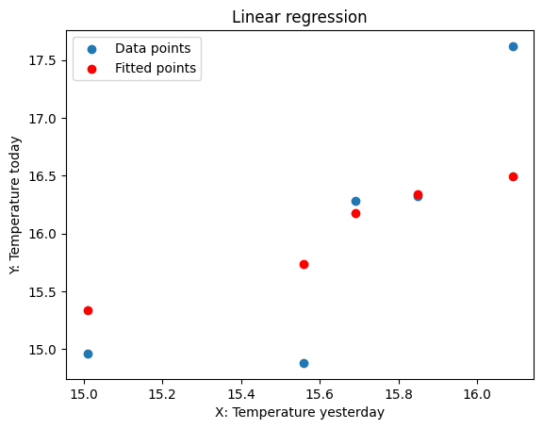
Extension 1: multiple features
New predict function:
def predict(X, w1, w2, b):
return w1 * X + w2 * X2 + b
New gradients
New update for w2
Otherwise identical

Slide 30
Extension 2: classification
Suppose y was defined as either hot (y = 1) or cold (y = 0)
When we make a prediction we need them to be between 0 and 1 (or exactly 0 and 1)
Use an activation function to make predictions
def sigmoid(x):
return 1 / (1 + np.exp(-x))
y_pred = sigmoid(w1 * X + w2 * X2 + b)

Slide 31
New loss function
def binary_cross_entropy(y_true, y_pred):
epsilon = 1e-15
y_pred = np.clip(y_pred, epsilon, 1 - epsilon)
return -np.mean(y_true * np.log(y_pred) + (1 - y_true) * np.log(1 - y_pred))
The clipping and the epsilon avoid us from creating log(0)
When y_true = 1 it’s just the log of the prediction, and when y_true = 0 it’s the log of 1 minus the prediction
Averaged over all the data points

Slide 32
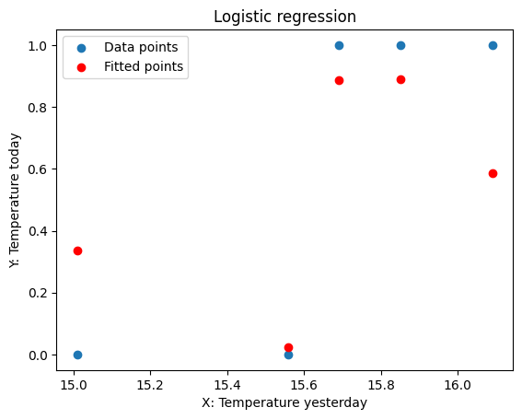
Results
Epoch 0, Loss: 0.6931, w1: 0.0013, w2: -0.0127, b: -0.0001
Epoch 10, Loss: 0.6091, w1: 0.0146, w2: -0.1398, b: -0.0014
Epoch 20, Loss: 0.5366, w1: 0.0279, w2: -0.2670, b: -0.0026
Epoch 30, Loss: 0.4747, w1: 0.0412, w2: -0.3941, b: -0.0038
Epoch 40, Loss: 0.4223, w1: 0.0545, w2: -0.5212, b: -0.0051
Epoch 50, Loss: 0.3782, w1: 0.0678, w2: -0.6483, b: -0.0063
Epoch 60, Loss: 0.3409, w1: 0.0810, w2: -0.7755, b: -0.0075
Epoch 70, Loss: 0.3094, w1: 0.0943, w2: -0.9026, b: -0.0088
Epoch 80, Loss: 0.2826, w1: 0.1076, w2: -1.0297, b: -0.0100
Epoch 90, Loss: 0.2597, w1: 0.1209, w2: -1.1568, b: -0.0112

Slide 33
Summary
Key ingredients: loss function, prediction function, gradients
Loop through using gradient descent to optimise the weights and the biases
Run over epochs until the parameters converge
Use the final values as your final model to predict
All code available to re-create these plots in the Github repository

